Slide 1

M.L.PARMAR COLLEGE OF COMPUTER SCIENCE & IT
BACHELOR OF COMPUTER APPLICATION
(B.C.A 6 TH SEMESTER)
YEAR: 2025-26
PNP Sales Analysis

Slide 2
Introduction
Data analytics is the process of examining raw data to extract meaningful insights, patterns, and trends.
It helps organizations make informed decisions and improve performance.
In this project, we analyze a sales dataset downloaded from Kaggle.
The objective is to understand customer behavior, product performance, and sales trends using Python libraries such as Pandas, NumPy, Matplotlib, and Seaborn.

Slide 3
Description
The dataset contains 11,251 records and 15 columns. It represents customer purchase data including personal details, product information, and transaction values.
Columns in Dataset:
User_ID → Unique ID of customer
Cust_name → Customer name
Product_ID → Unique product ID
Gender → Male/Female
Age Group → Age category
Age → Customer age
Marital_Status → Married/Unmarried

Slide 4
State → Customer state
Zone → Region of customer
Occupation → Customer profession
Product_Category → Type of product
Orders → Number of ordersAmount → Total purchase amount
Status → (Mostly empty / irrelevant)
unnamed1 → Empty column (to be removed)
Data Cleaning Steps:
Removed unnecessary columns (Status, unnamed1)
Handled missing values
Converted data types where required
Checked duplicates

Slide 5
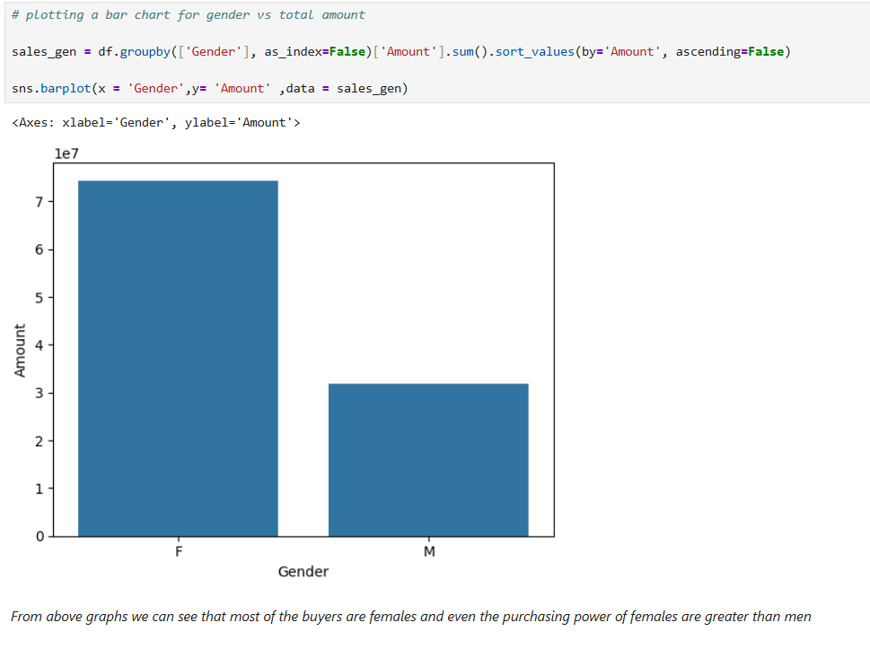
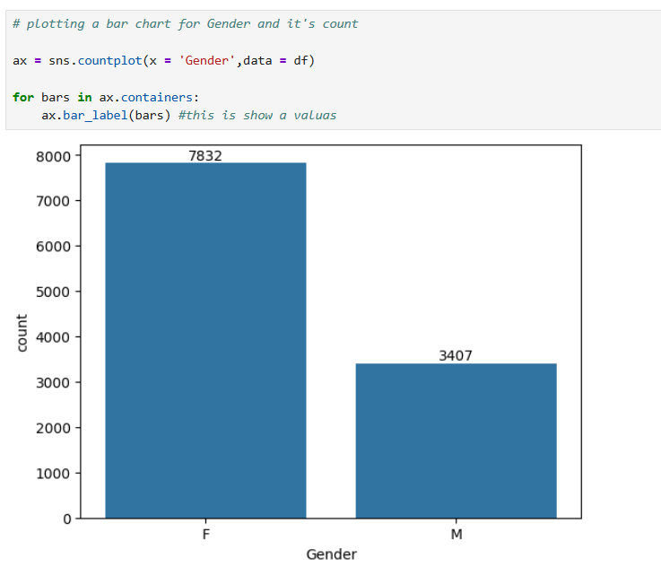
Analysis and Outputs
Gender-Based Analysis :
Female customers contribute more to total sales.
Women tend to shop more frequently than men.

Slide 6
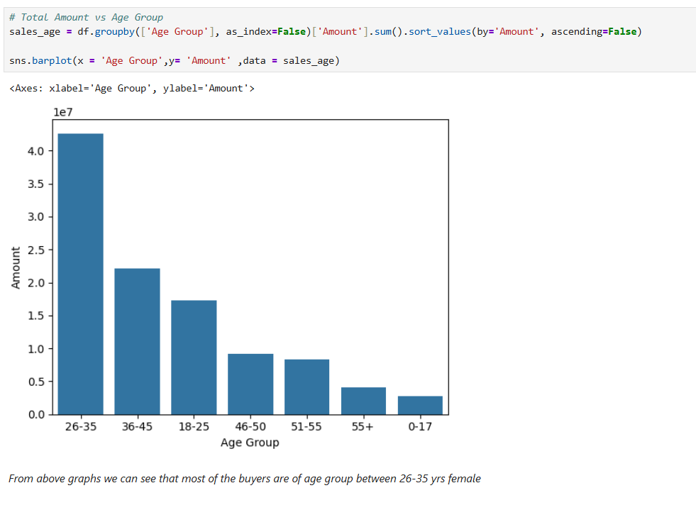
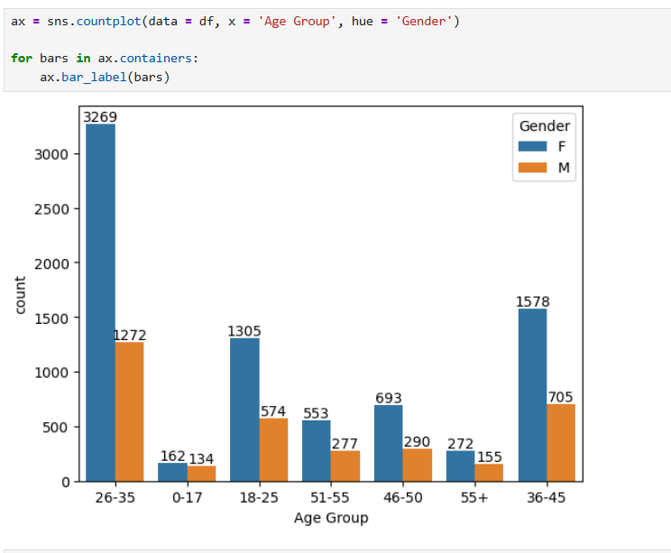
Age Group Analysis:
Highest sales come from the 26–35 age group.
Young adults are the primary buyers.

Slide 7
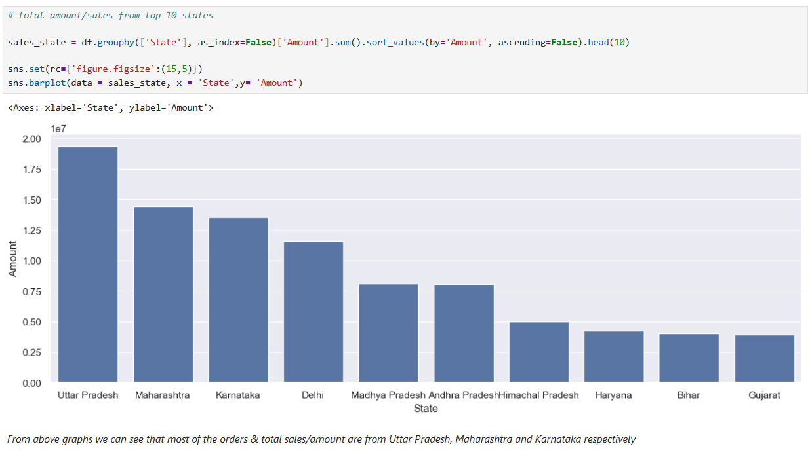
State-wise Sales:
Top contributing states:
Uttar Pradesh, Maharashtra, Karnataka

Slide 8
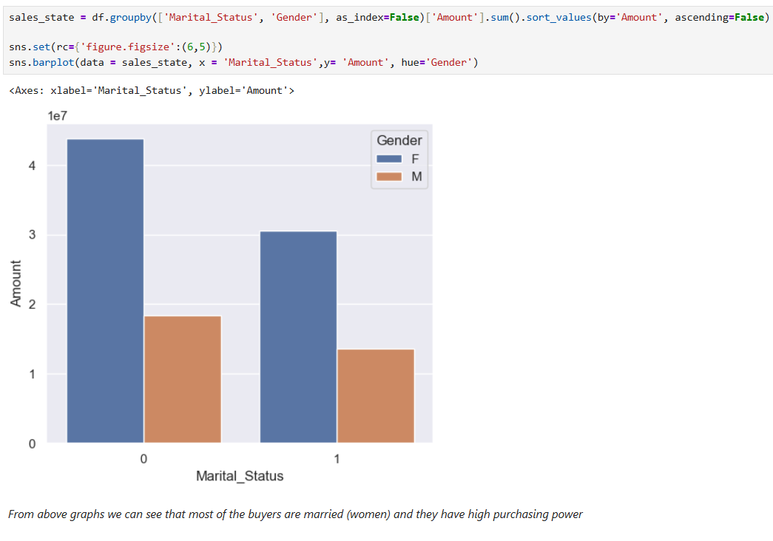
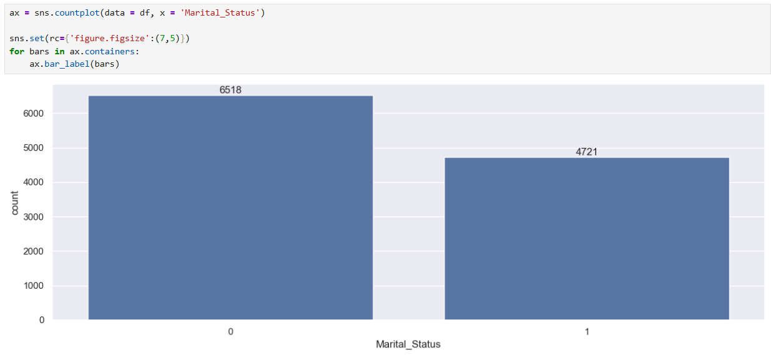
Marital Status Analysis:
Married customers show higher purchasing power.

Slide 9
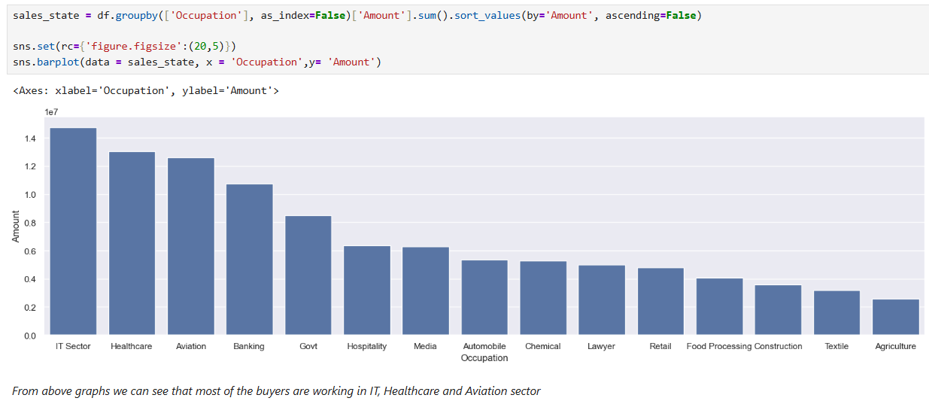
Occupation Analysis:
Highest sales from:
IT sector, Healthcare, Aviation

Slide 10
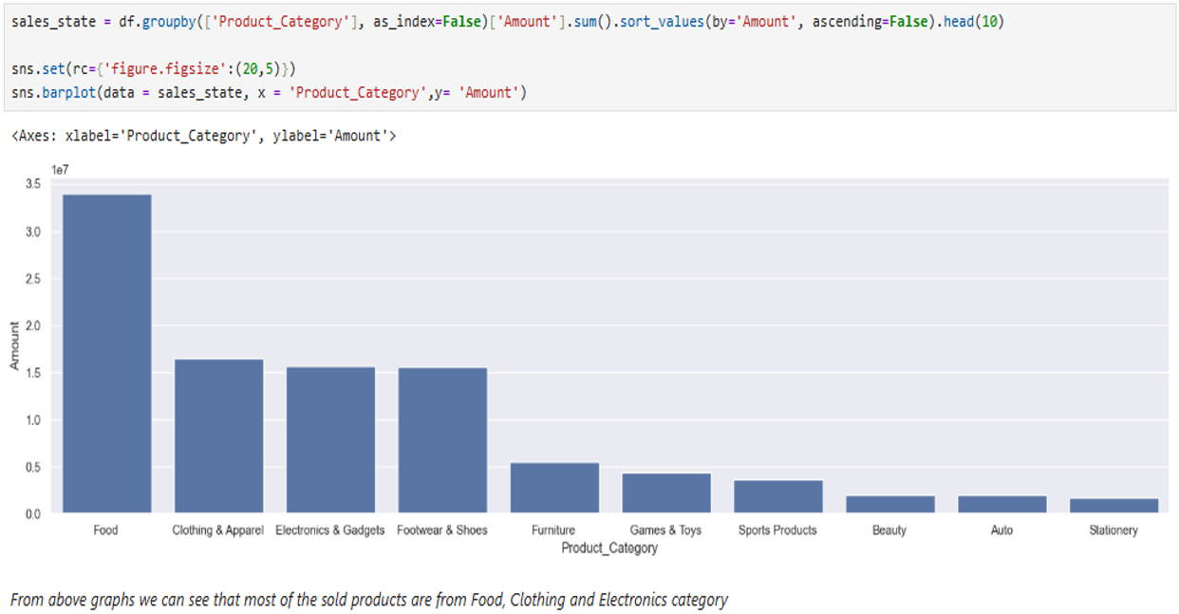
Product Category Analysis:
Most popular categories:
Food, Electronics, Clothing & Apparel

Slide 11
Observations
Female customers are the major buyers in the dataset.
Age group 26–35 dominates purchasing activity.
Married individuals spend more compared to unmarried ones.
Certain states contribute significantly to overall revenue.
Product categories like clothing and electronics are highly demanded.
Occupation plays an important role in purchasing capacity.

Slide 12
Conclusion
This analysis provides valuable insights into customer behavior and sales patterns. Businesses can use this data to:
Target female customers more effectively
Focus marketing on the 26–35 age group
Increase inventory for high-demand product categories
Expand operations in high-performing states
Customize offers based on occupation and marital status

Slide 13
Tools & Technologies Used
Python
Pandas
NumPy
Matplotlib
Seaborn
Jupyter Notebook

Slide 14
Thank you

